Slide 1
For Live Session Assignment Unit 3
Assumption of the T Test

Slide 2
Part 1

Slide 3
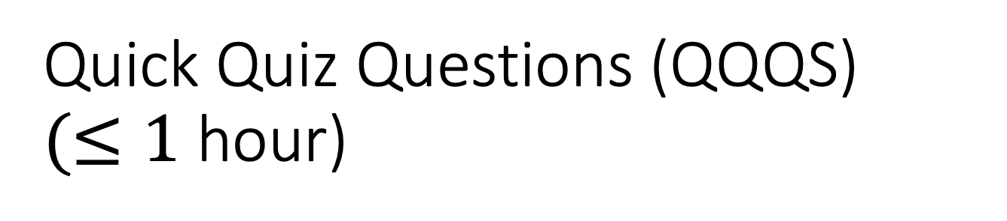
Quick Quiz Questions (QQQS) $(≤1$ hour)

Slide 4
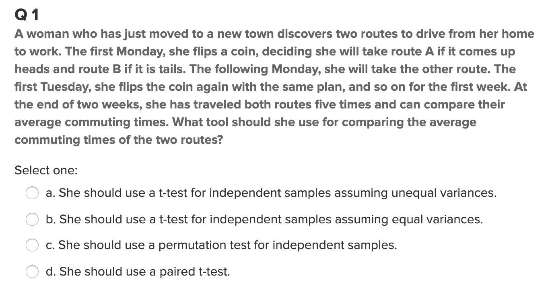
Question 1

Slide 5
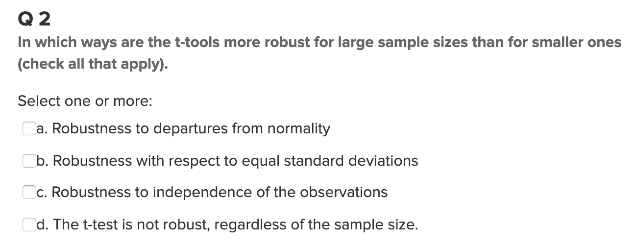
Question 2

Slide 6
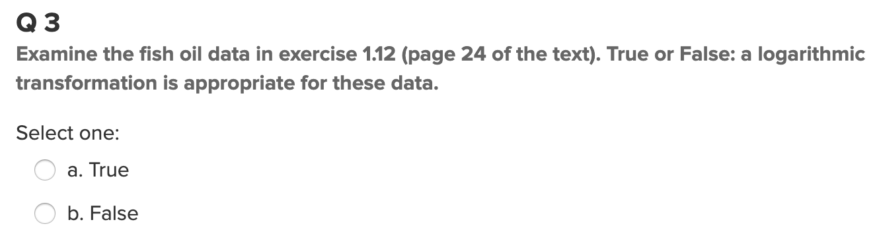
Question 3

Slide 7
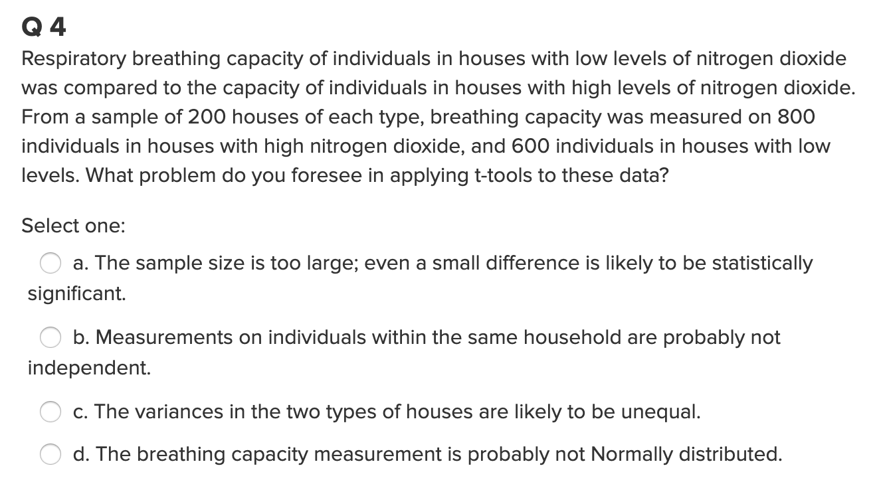
Question 4

Slide 8
End Quick Quiz Questions (QQQs)

Slide 9
End Part 1

Slide 10
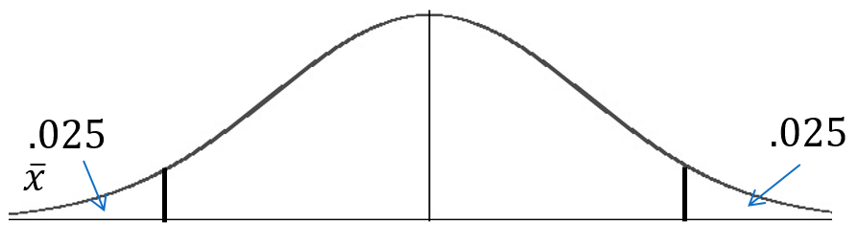
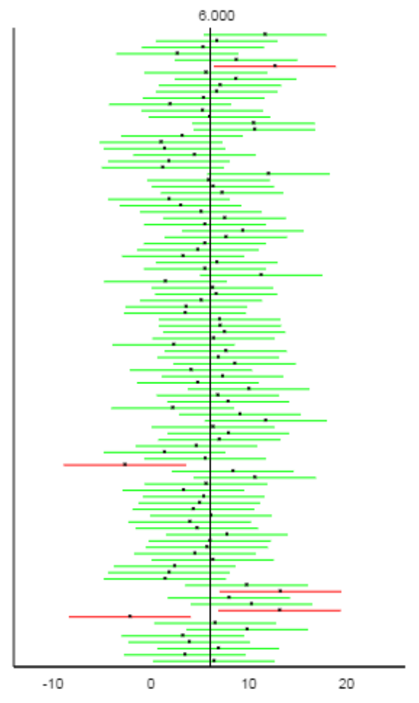
Confidence Intervals and Hypothesis Tests
α = .05
95% CI
Vs.
α = .05 Hyp Test
For the corresponding alpha, a (1-alpha)% CI will contain X when the test of Ho: mu = X fails to reject Ho and will not contain X when the test rejects Ho.
Notes:
The point here is that

Slide 11
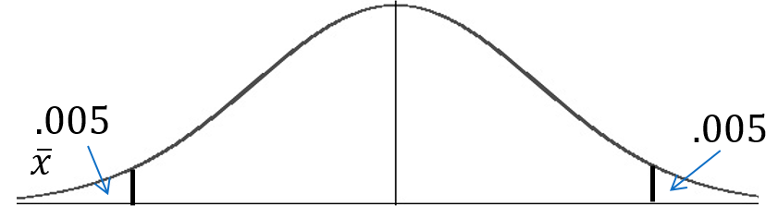
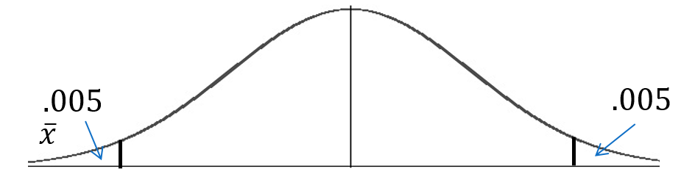
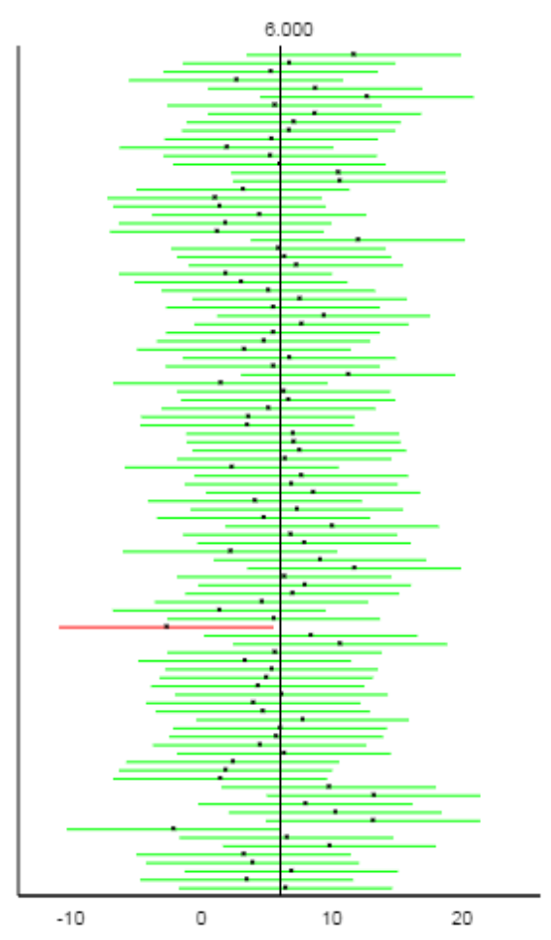
α = .01
Confidence Intervals and Hypothesis Tests
99% CI
Vs.
α = .01 Hyp Test

Slide 12
The Take Away
(1-α)% Confidence Intervals are Equivalent to Hypothesis Tests that have an α level of significance.
“Equivalent” here means that if we test any specific value in the interval, the test will FTR Ho. And if we test any specific value outside the interval, the test will Reject Ho.
Example:
95% confidence interval for the mean is equivalent to an α = .05 hypothesis test.
Example:
99% confidence interval for the mean is equivalent to an α = .01 level hypothesis test.

Slide 13
Let’s Look at this Equivalence from the Hypothesis Test Point of View!

Slide 14
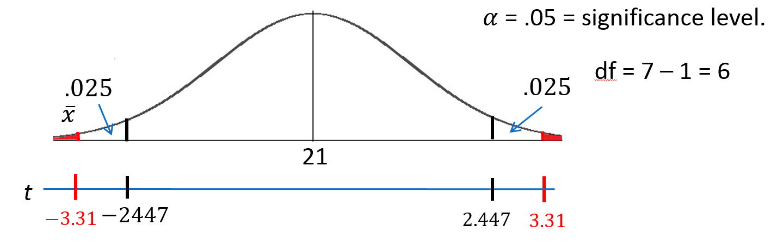
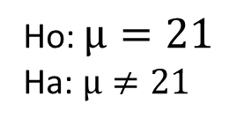
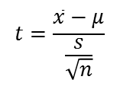
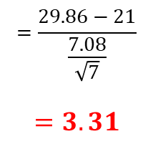
Beach Comber patron ages: Revised Write Up!
We would like to test the claim that the population mean is different from $21.$ To do this, we take a sample of size n = 7 and find that $\overline{x}$ = 29.86 years and s = 7.08 years.
Ho: $µ=21$
Ha: $µ≠21$
Step 1: Identify the null (Ho) and alternative (Ha) hypothesis.
Step 2: Draw and Shade and Find the Critical Value.
$$t=\frac{\overline{x}−μ}{\frac{s}{\sqrt{n}}}$$
$$=\frac{29.86−21}{\frac{7.08}{\sqrt{7}}}$$
$$=3.31$$
Step 3: Find the test statistic. (The t value for the data.)
Step 4: Find the p-value: P-value = .0162 < .05
Step 5: REJECT Ho
Step 6: There is sufficient evidence to conclude that the true mean age of patrons at the Comber at 7pm is different from 21 (p-value =.0162 from a t-test). A 95% confidence interval for the mean age is (23.3, 36.4) years. (Note that we have sufficient evidence to support the claim that the mean is greater than 21, because the burden of proof to reject a one-sided test is less than that of a two-sided test.)

Slide 15
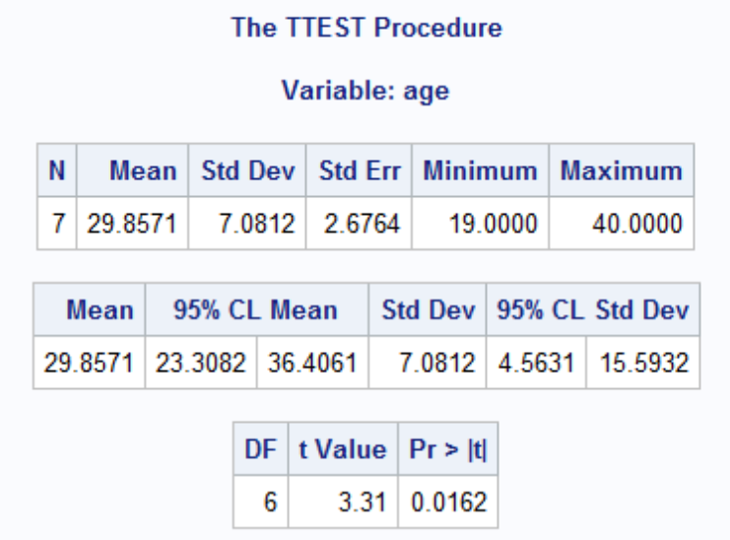
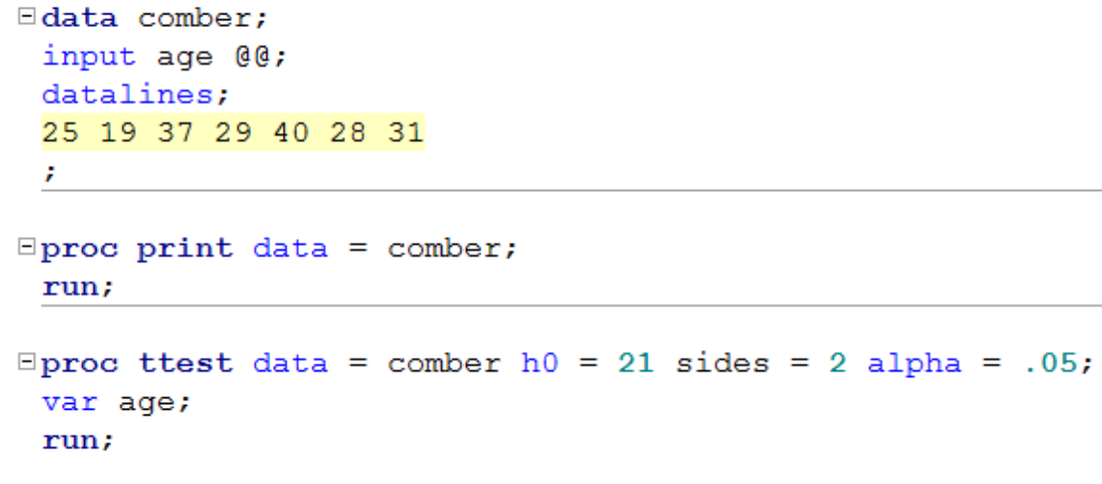
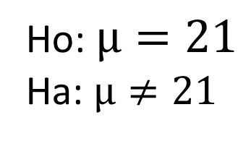
Finding the P-value
Ho: $µ=21$
Ha: $µ≠21$
Step 4: Find the p-value: P-value < .05
You could use Stat Trek / or the t-table.
OR
Software like SAS:
What do you think would happen if we tested Ho: $µ=22$ instead of 21?

Slide 16
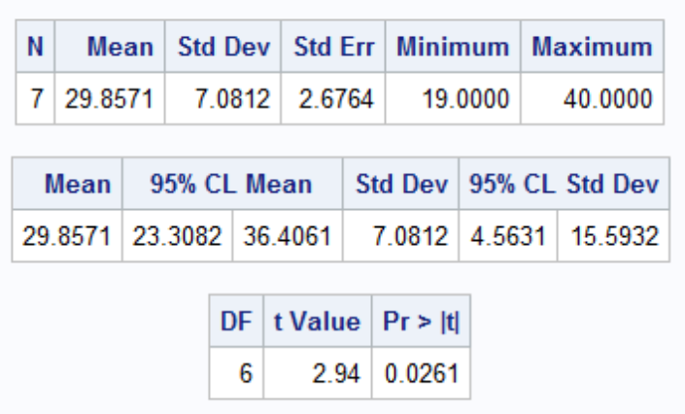
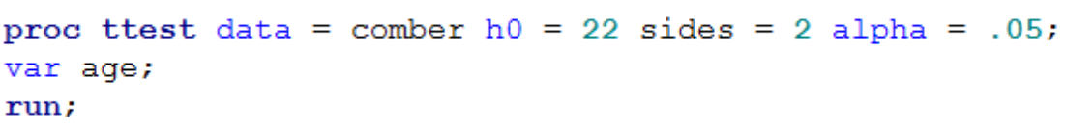
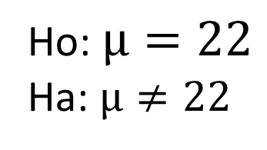
Finding the P-value
Ho: $µ=22$
Ha: $µ≠22$
Step 4: Find the p-value: P-value < .05
You could use Stat Trek / or the t-table.
OR
Software like SAS:
What do you think would happen if we tested Ho: $µ=37$?

Slide 17
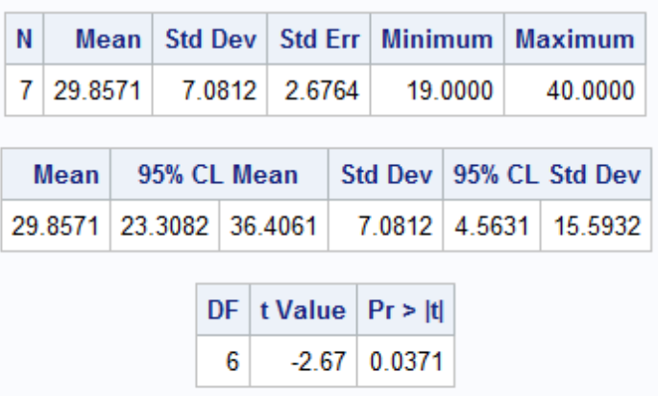
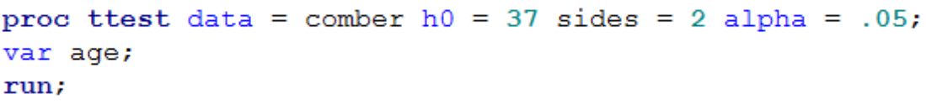
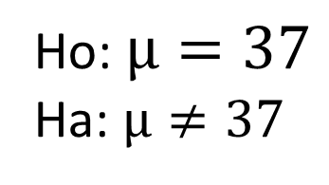
Finding the P-value
Ho: $µ=37$
Ha: $µ≠37$
Step 4: Find the p-value: P-value < .05
You could use Stat Trek / or the t-table.
OR
Software like SAS:
What do you think would happen if we tested Ho: $µ=31$?

Slide 18
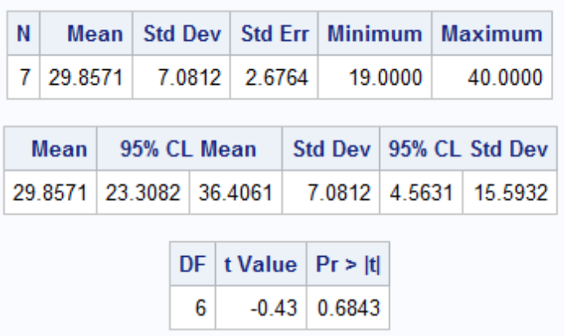
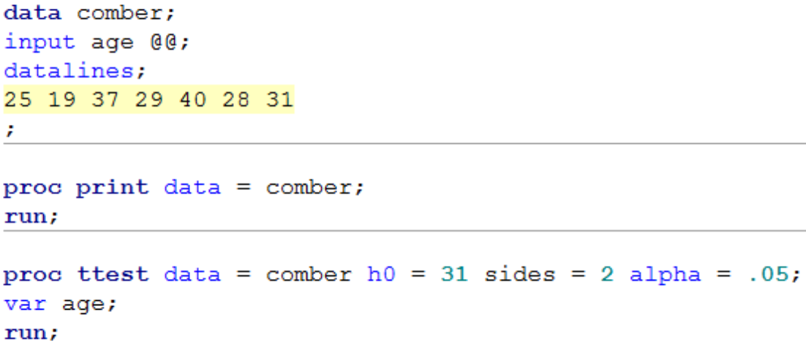
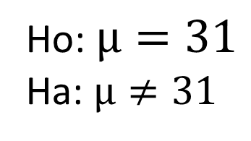
Finding the P-value
Ho: $µ=31$
Ha: $µ≠31$
Step 4: Find the p-value: P-value < .05
You could use Stat Trek / or the t-table.
OR
Software like SAS:
What do you think would happen if we tested Ho: $µ=23.2$?

Slide 19
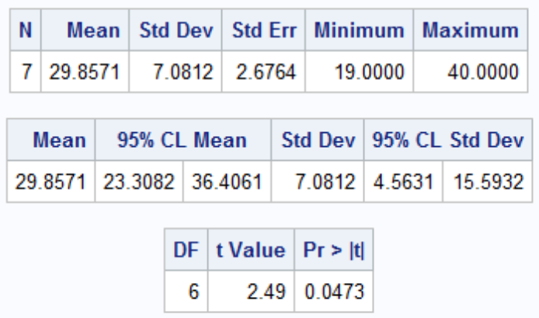
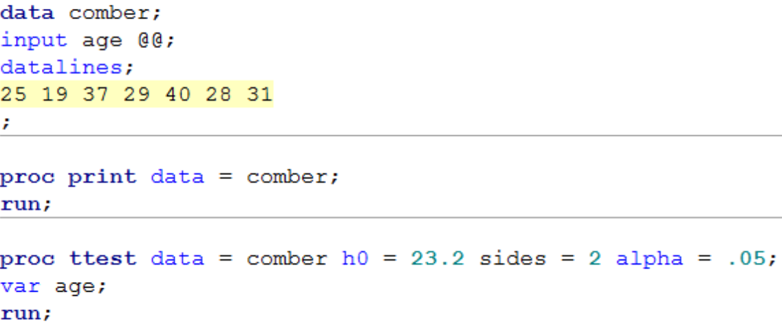
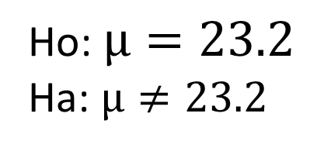
Finding the P-value
Ho: $µ=23.2$
Ha: $µ≠23.2$
Step 4: Find the p-value: P-value < .05
You could use Stat Trek / or the t-table.
OR
Software like SAS:

Slide 20
The Take Away
100(1-α)% Confidence Intervals are Equivalent to Hypothesis Tests that have an α level of significance.
“Equivalent” here means that if we test any specific value in the interval, the test will FTR Ho. And if we test any specific value outside the interval, the test will Reject Ho.
Example:
95% confidence interval for the mean is equivalent to an α = .05 hypothesis test.
Example:
99% confidence interval for the mean is equivalent to an α = .01 level hypothesis test.
So we can evaluate hypothesis tests through the evaluation of confidence intervals!

Slide 21
Assumptions of one sample T-Tests
Samples are drawn from a normally distributed population.
The observations in the sample are independent of one another.

Slide 22
Robustness of One Sample T-test / CI
When the original (population) distribution is not normal, the one sample t-test is still valid with a large enough sample size. (Central Limit Theorem)
That is, the one sample t-test is robust to the normality assumption when the sample size is large enough.

Slide 23
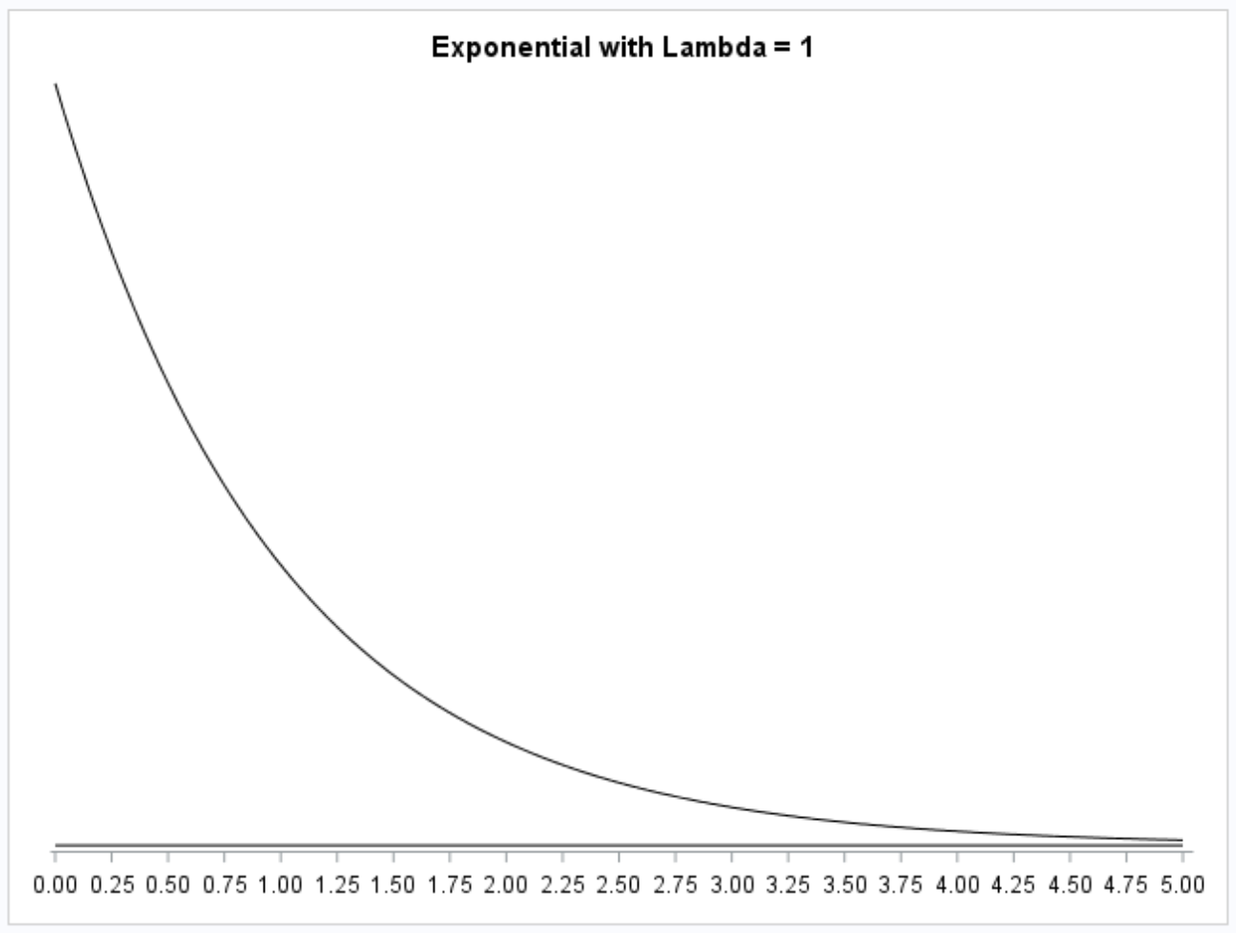
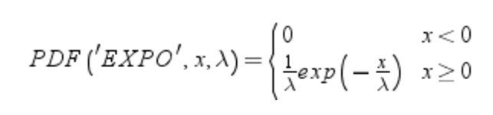
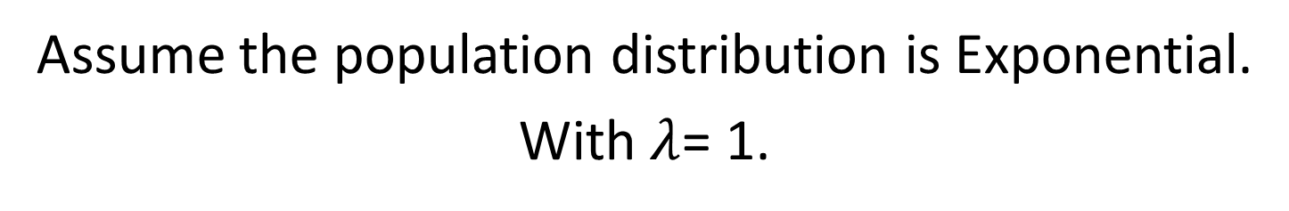
Assume the population distribution is Exponential.
With $λ$= 1.

Slide 24
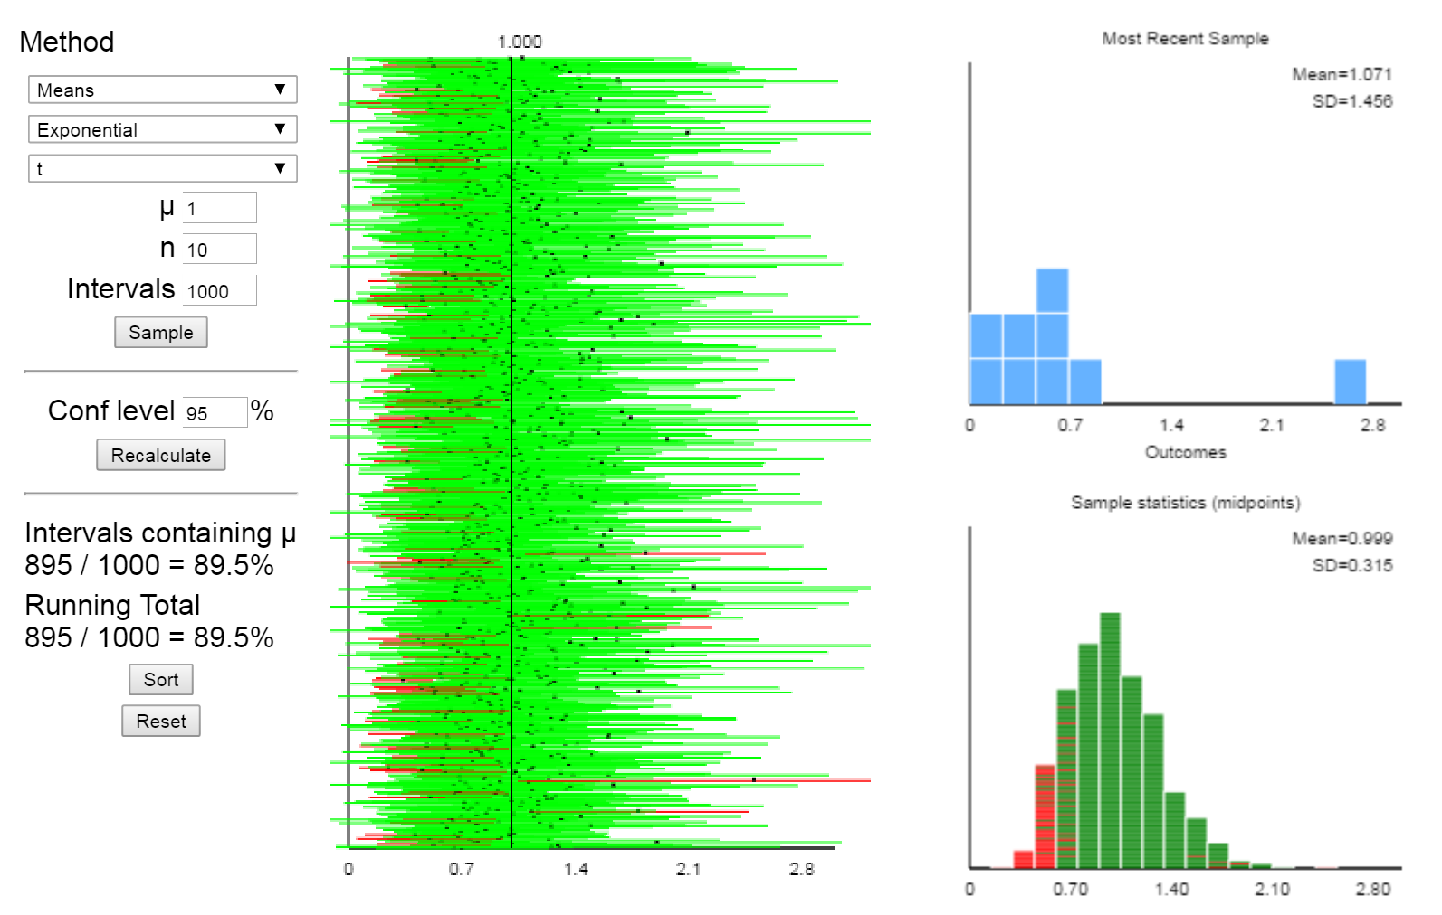
1000 CIs for the Mean of an Exponential(1) Distribution: n = 10
Note the
Right Skew!
Note the
Right Skew!

Slide 25
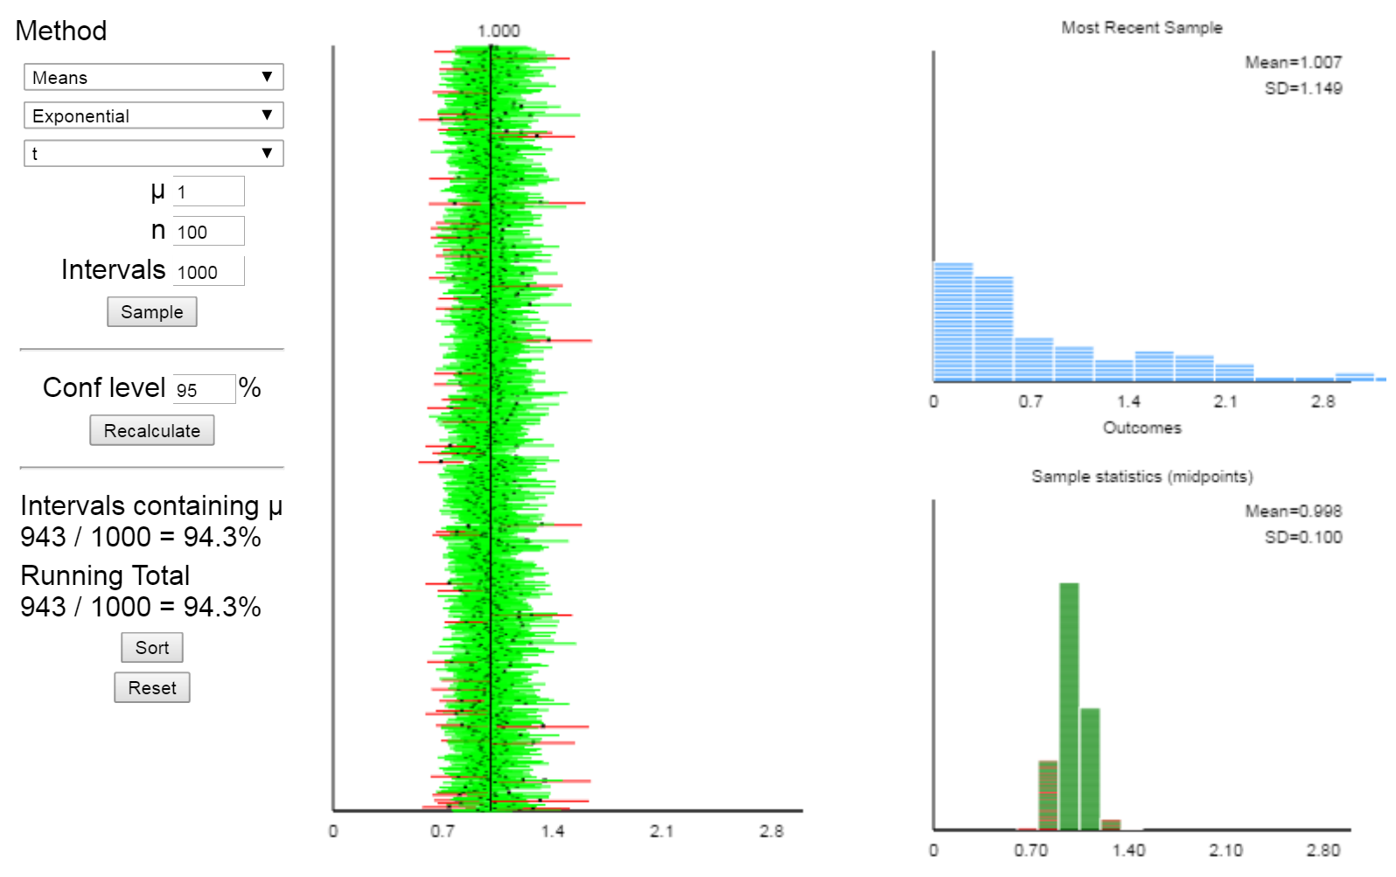
1000 CIs for the Mean of an Exponential(1) Distribution: n = 100
Note the
Right Skew!
Note the greater symmetry and smaller standard deviation.

Slide 26
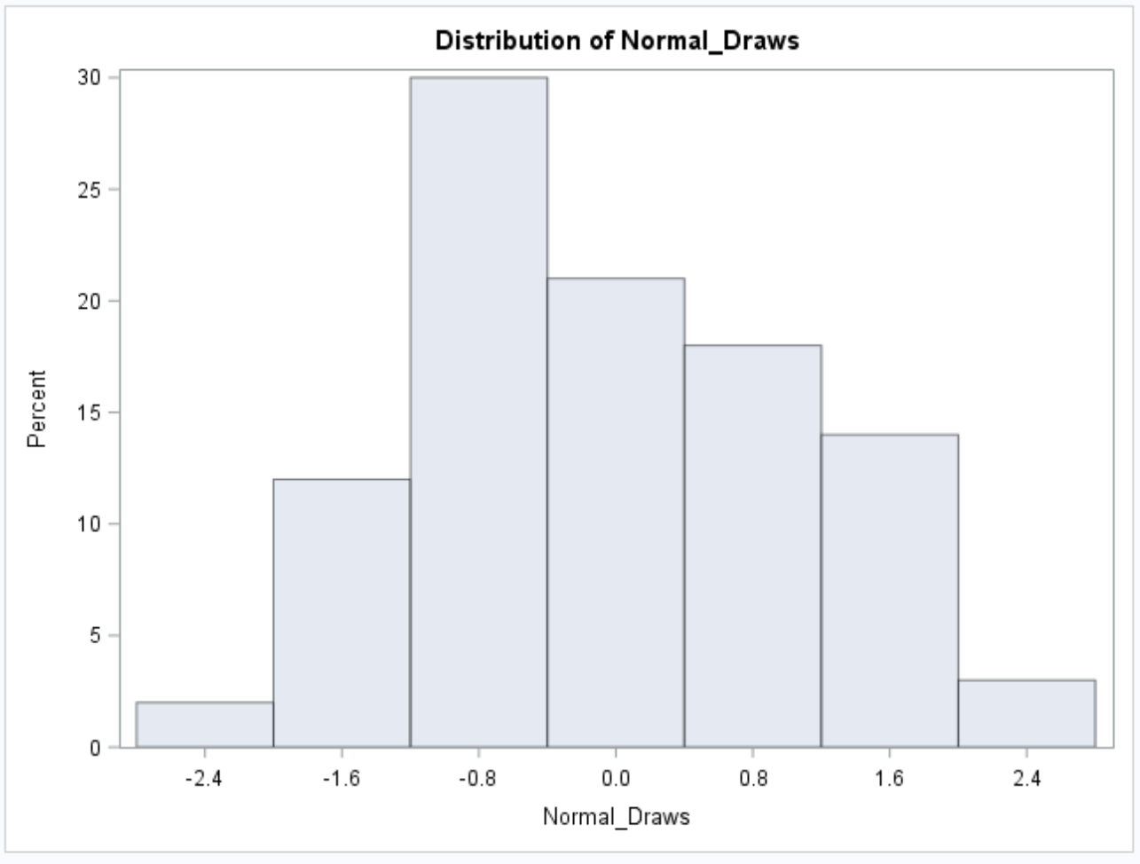
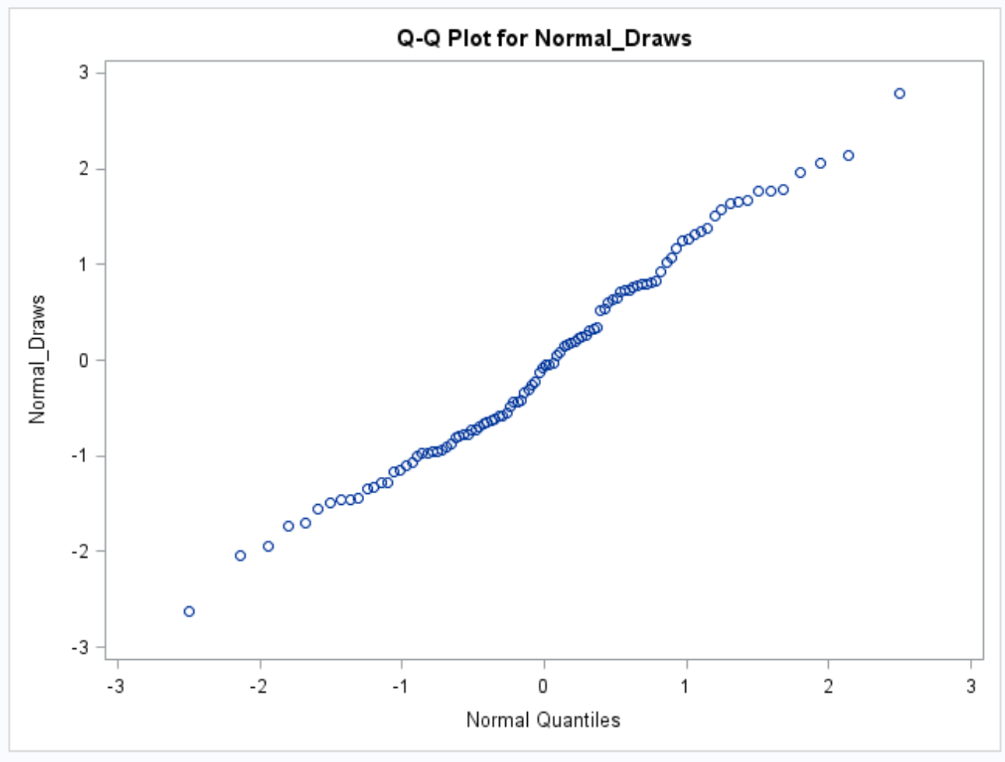
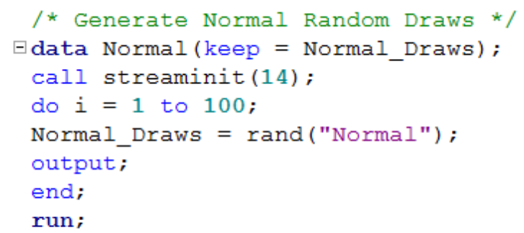
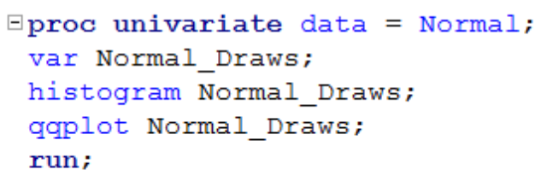
Given Data, How Do We Check the Normality Assumption? Visually!
n = 100
n = 100
Histogram
q-q Plot

Slide 27
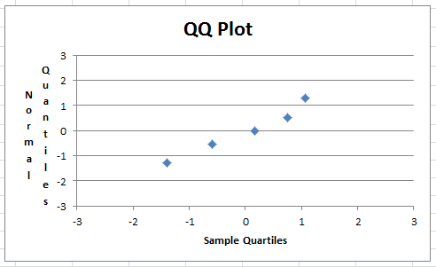
Normal q-q Plot
DATA
41.2
76.6
109.3
134.5
148.6
Q-Q plots are constructed differently depending on the software or textbook, but usually include some combination of the above columns. If the graph plots green vs. green or orange vs. orange, if the data is normal, then points should fall close to the line y=x. If one green and one orange are used, if the data is normal, the points should fall along a straight line, but not necessarily one with slope=1. Different software will calculate this line differently.

Slide 28
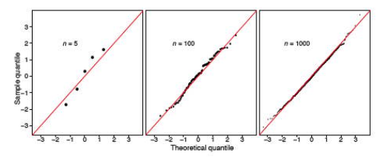
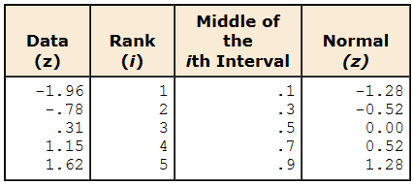
Normal q-q Plot

Slide 29
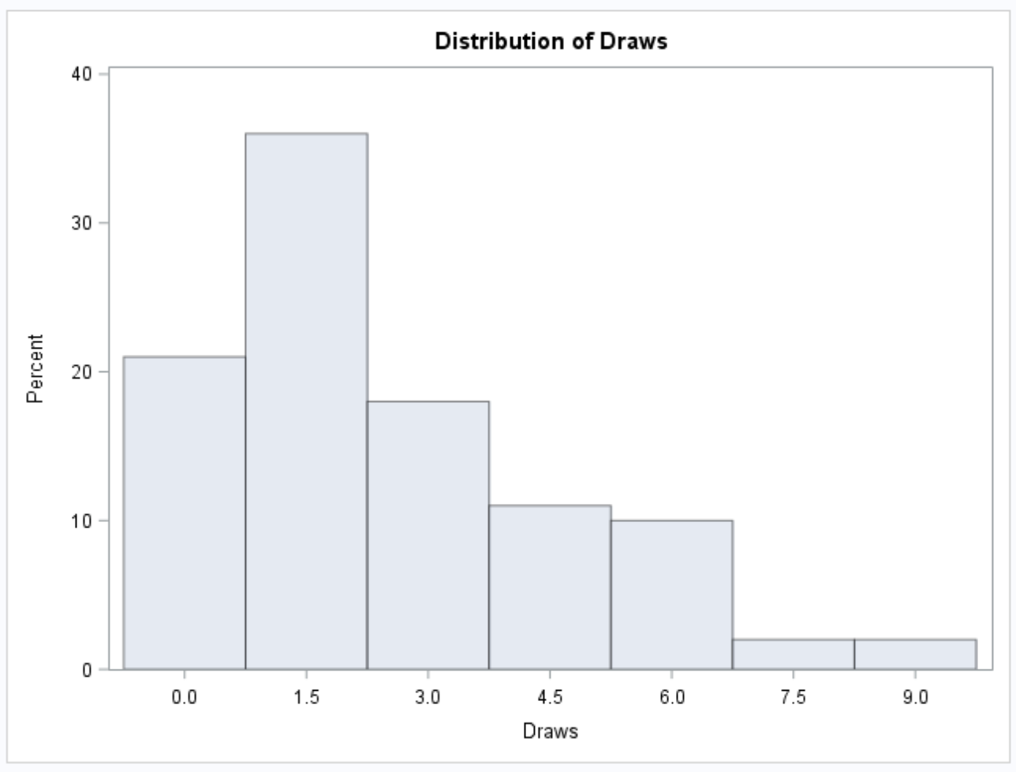
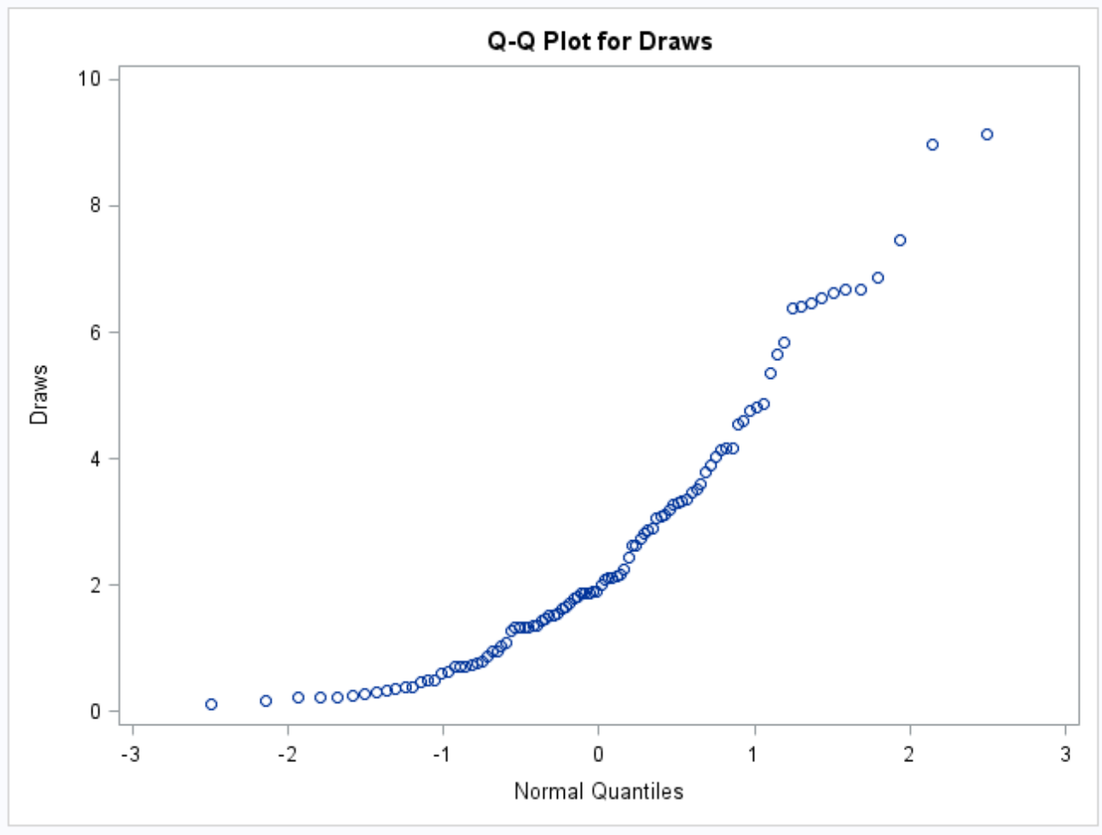
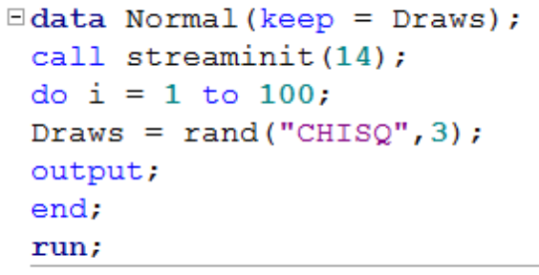
Given Data, How Do We Check the Normality Assumption? Visually!
n = 100
n = 100
Histogram
q-q Plot
Not normal! Data is skewed to the right and does not fall along a straight line in this q-q plot.

Slide 30
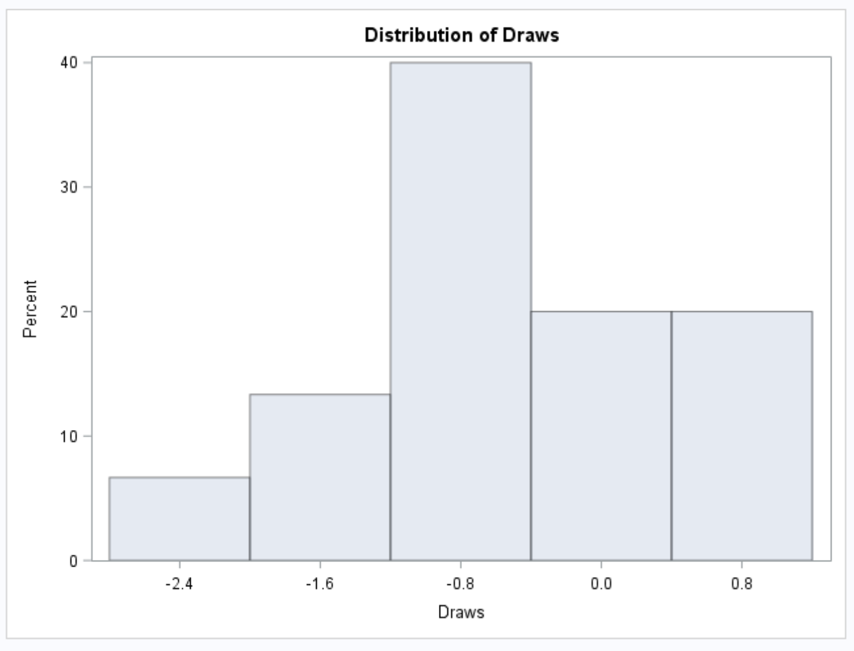
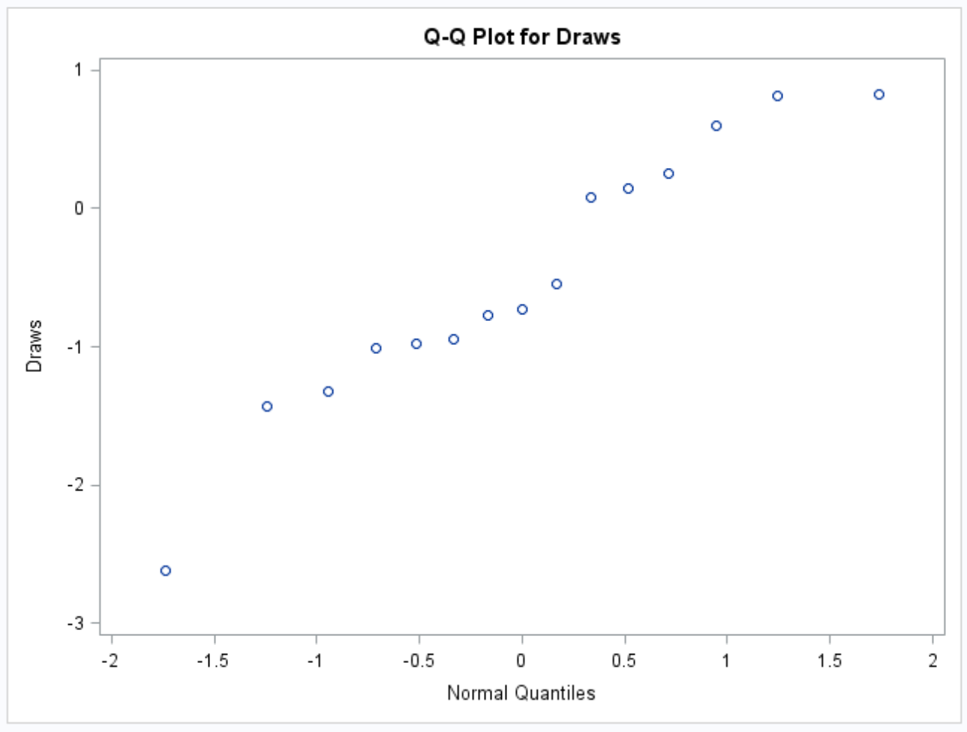
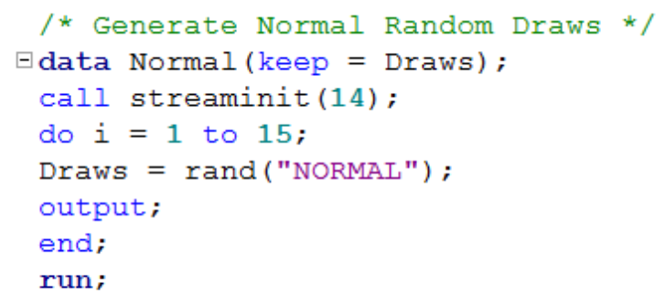
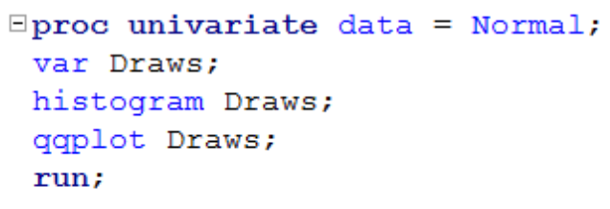
Given Data, How Do We Check the Normality Assumption? Visually!
n = 15
n = 15
Histogram
q-q Plot
Data comes from a normal distribution, but it is hard to tell given the small sample size.

Slide 31
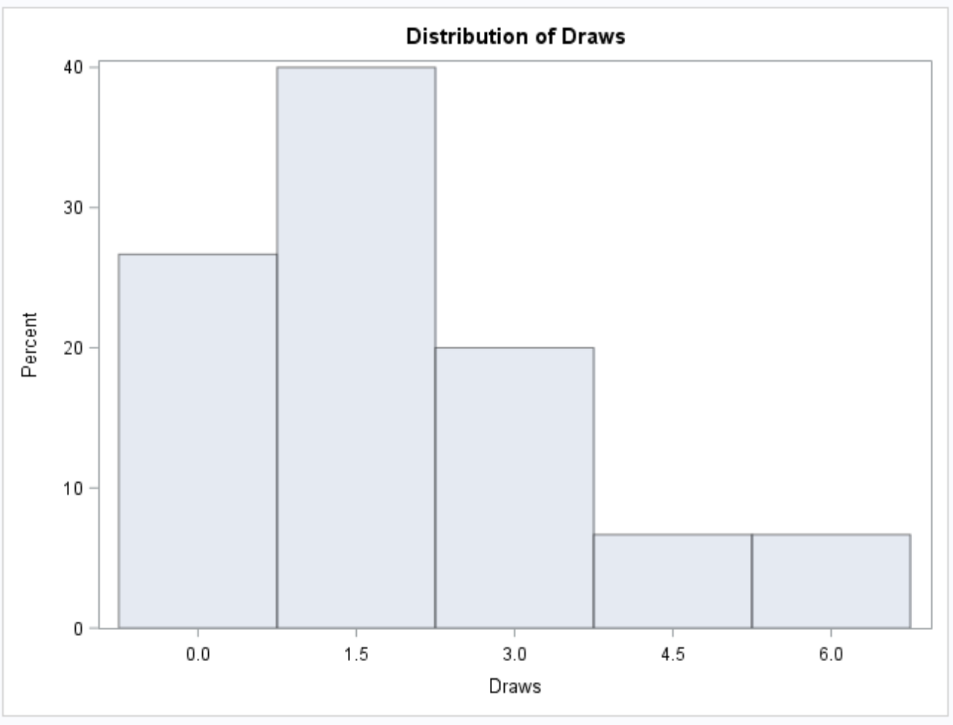
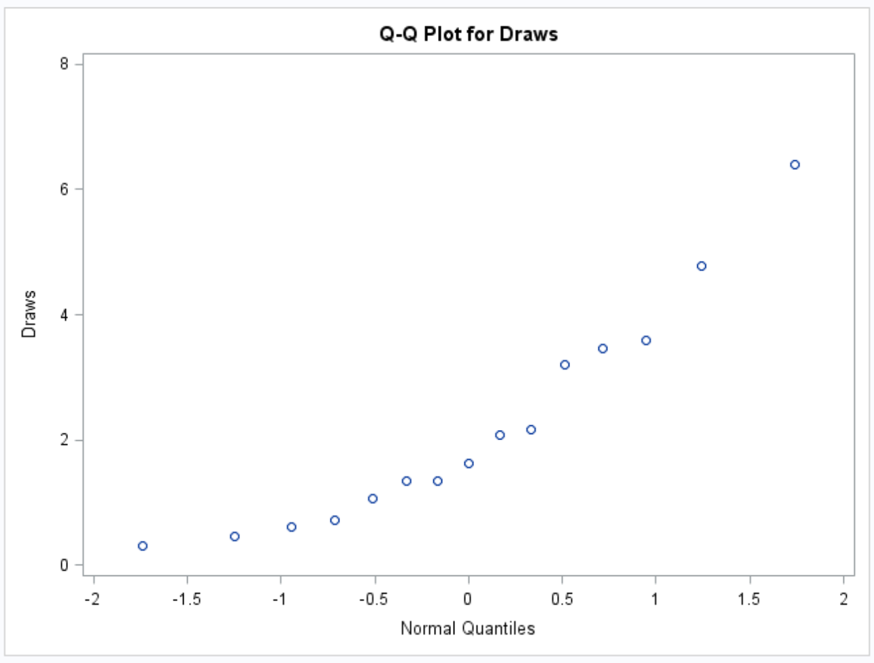


Given Data, How Do We Check the Normality Assumption? Visually!
n = 15
n = 15
Histogram
q-q Plot
It looks like the data might not be normal (skew, curvature of q-q plot), but it is hard to tell with this small sample size.

Slide 32



Beware of small sample sizes!
n = 15
n = 15
Histogram
q-q Plot
The histogram shows an almost bimodal distribution (definitely not normal), but again it is hard to tell with small sample sizes. The q-q plot does not look too far away from normality.

Slide 33
A Way to Decide:
 | Small Sample Size | Large Sample Size
Little to no Evidence Against Normality | No Problem if you feel Normality is a safe assumption … run the T-Test. (You may want to be “conservative” here and run a test with fewer assumptions.) | No Problem! Run the T-Test
Significant Evidence Against Normality | Assumptions are not met and test is not robust here … Try a transformation and, if appropriate, run a t-test. If not appropriate, do NOT run the T-Test and proceed to a test with fewer / different assumptions. | No Problem .. You have the Central Limit Theorem. Run the T-Test.

Slide 34
A Complete Analysis:
Statement of the Problem
Address the Assumptions
Perform the Appropriate Test (5 Steps)
Step 6: Provide a conclusion that a non statistician can understand, include a p-value and confidence interval.
Scope of Inference

Slide 35

Example: Beach Comber
The following are ages of 7 randomly chosen patrons seen leaving the Beach Comber in South Mission Beach at 7pm! We assume that the data come from a normal distribution and would like to test the claim that the mean age of the distribution of Comber patrons is different than 21.
25, 19, 37, 29, 40, 28, 31

Slide 36


Example: Comber
PROBLEM STATEMENT:
Test the claim that the mean age of Beach Comber patrons at 7pm is different from 21.
ASSUMPTIONS:
Normal Population Distribution: Judging from the histogram and q-q plots, there is little to no evidence that the population distribution of patron ages at the Comber at 7pm is not normal. We will assume that this distribution is normal and proceed.
Independence: These subjects were randomly selected from the population; thus, we will assume that the observations are independent.

Slide 37

Revised Write Up!
We would like to test the claim that the population mean is different from $21.$ To do this, we take a sample of size n = 7 and find that $\overline{x}$ = 29.86 years and s = 7.09 years.
Ho: $µ=21$
Ha: $µ≠21$
Step 1: Identify the null (Ho) and alternative (Ha) hypothesis.
Step 2: Draw and Shade and Find the Critical Value.
$$t=\frac{\overline{x}−μ}{\frac{s}{\sqrt{n}}}$$
$$=\frac{29.86−21}{\frac{7.09}{\sqrt{7}}}$$
$$=3.31$$
Step 3: Find the test statistic. (The t value for the data.)
Step 4: Find the p-value: P-value = .0162 < .05
Step 5: REJECT Ho
Step 6: There is sufficient evidence to conclude that the true mean age of patrons at the Comber at 7pm is different from 21 (p-value =.0162 from a t-test). A 95% confidence interval for the mean age is (23.3, 36.4) years. Scope: Since this was a random sample, we can generalize these findings to the entire population of Comber patrons at 7pm. Note that we have evidence to support the claim that the mean age is greater than 21 as well.

Slide 38


Example: Bats

Slide 39


Example: Bats
PROBLEM STATEMENT:
Test the claim that the mean weight of the bumble bee bat is different from 1.8 g.
ASSUMPTIONS:
Normal Population Distribution: Judging from the histogram and q-q plots, there is some visual evidence of a departure from normality. With a sample size of 15 and no extreme outliers, we will assume the distribution of sample means is well approximated by a normal distribution via the CLT and proceed with caution.
Independence: Not much is known about the sampling scheme used to obtain this sample. We will assume the observations are independent.

Slide 40




H₀: $μ$= 1.8
H₁: $μ$ ≠ 1.8
$α$ = 0.05
$\overline{x}$= 1.713
s = .2588
Critical Values
t = ± 2.145
Test Statistic
P-value: .2155 > .05
Fail to Reject H₀
t = -1.297
On the basis of this test, there is not enough evidence to reject the claim that the mean weight of bumblebee bats is equal to 1.8 g (p-value = .2155 from a t-test). A 95% confidence interval is (1.57, 1.8566) grams. The problem was ambiguous on the randomness of the sample; thus, we will assume that it was not a random sample, which makes inference to all bats strictly speculative.

Slide 41
Assumptions of one and two sample T-Tests
Samples are drawn from a normally distributed population.
If it is a two sample test, both populations are assumed to have the same standard deviation (same shape).
The observations in the sample are independent of one another.

Slide 42







What happens if the normality assumption is broken?
Many times ….
NO PROBLEM!!!
x
x
$$Cental Limit Theorem$$
$$\overline{x}$$
$$\overline{x}$$
$$μ_{1}$$
$$μ_{2}$$

Slide 43

When data is not normal

Slide 44




2. In a two sample test, both populations are assumed to have the same standard deviation (same shape).
$${Assume: σ}_{1}=σ_{2}$$
$$μ_{1}$$
$$μ_{2}$$
${We want inference on : μ}_{2}−$ $μ_{1}$

Slide 45


Evidence of Inequality of Variance: VISUAL
Strong visual evidence against equal standard deviations (variances).

Slide 46

Evidence of Inequality of Variance: VISUAL
Little visual evidence against equal standard deviations (variances).

Slide 47

Evidence of Inequality of Variance: F-Test for Equal Variance
Ho: population variances are equal
Ha: population variances are not equal
There is not sufficient evidence to conclude the variances are different (p-value = .1043 from a F-Test.)

Slide 48

Evidence of Inequality of Variance: F-Test for Equal Variance
Ho: population variances are equal
Ha: population variances are not equal
There is not sufficient evidence to conclude the variances are different (p-value = .4289 from a F-Test.)

Slide 49
Evidence of Inequality of Variance: F-Test / VISUAL
The F-test has a strong assumption that the two populations that it is testing the variances of must be normal. It is not robust to this assumption. Since the second distribution has strong evidence of right skew, the F-test for Equal Variance is not appropriate here.
For this example, the visual evidence is so strong that we would not need to consult a hypothesis test to test this assumption of equal variances.
However, later in the semester we will study a test of spread/dispersion that does not have this assumption and can be used in a wider range of statistical environments.

Slide 50
What happens if the assumption of equal variances (standard deviations) is broken?
In some circumstances ….
This could be serious …. In others…..
No Problem!

Slide 51

When variances are not equal

Slide 52
The Take Away
What you will find in practice will most likely not fit exactly into the scenarios identified here. There will be some judgment involved … this is the “art” of statistics.
Here are some general rules of thumb that we will assume this semester.
If sample sizes are the same and sufficiently large, the t tools (tests and confidence intervals) are valid … since they are robust to the violation of normality.
If the two populations have the same standard deviation, then the t tests are valid … given sufficient sample sizes.
If the standard deviations are different and the sample sizes are different then the t tools are not valid and another procedure should be used. (Ch. 4)

Slide 53
Break Out! LET’S TRY SOME!
For each of these data sets, write up the assumption statement with respect to checking the assumptions for a one or two sample t-test. You may assume the data to be independent.
Happiness Data Set
Mice Experiment Data Set

Slide 54


Happiness Study
5 randomly selected people were asked to rate their happiness on a scale from 1 – 100 on a cloudy day and 8 randomly selected people were asked the same question on a sunny day.
QOI: Is the mean happiness of individuals different on a cloudy day than a sunny day? If possible, can we test if cloudy weather causes a change in happiness?
Address each assumption of the two sample t-test and then decide if the two-sample t-test appropriate to answer this QOI with this data.

Slide 55
Happiness Study
5 randomly selected people were asked to rate their happiness on a scale from 1 – 100 on a cloudy day and 8 randomly selected people were asked the same question on a sunny day.
QOI: Is the mean happiness of individuals different on a cloudy day than a sunny day? If possible, can we test if cloudy weather causes a change in happiness?
Address each assumption of the two sample t-test and then decide if the two-sample t-test is appropriate to answer this QOI with this data.

Slide 56
Happiness Study
Normality of Distributions: Judging from the histograms and q-q plots, there is evidence of outliers in both the Cloudy and Sunny sets. The most pronounced outlier seems to be in the Sunny data set; thus, there is significant visual evidence against these data being normally distributed. In addition, we are not satisfied that the t-test will be robust to this assumption since the sample sized are so small.
Equal Standard Deviations: Judging from the histograms, q-q plots and box plots, there is significant visual evidence that the standard deviations are different. In addition, since the sample sizes are different we know that the t-test is not robust to this assumption.
Independence: We will assume that these data are independent.
The two sample t-test is not appropriate here. We should look for a different test.

Slide 57


Mice Study
A large sample of mice were randomly assigned to receive a drug or a placebo. The mice’s tcell counts were then taken and histograms and qq plots are displayed above.
QOI: Is the mean tcell count of mice that receive the drug greater than that of the mice that receive the placebo?
Can we draw draw evidence of causality from this study?
Address each assumption of the two sample t-test and then decide if the two-sample t-test appropriate to answer this QOI with this data.

Slide 58
Mice Study
A large sample of mice were randomly assigned to receive a drug or a placebo (sample size n_{D} = 32 and n_{P} = 32). The mice’s tcell counts were then taken and histograms and q-q plots are displayed above.
QOI: Is the mean tcell count of mice that receive the drug greater than that of the mice that receive the placebo?
Can we draw draw evidence of causality from this study?
Address each assumption of the two sample t-test and then decide if the two-sample t-test is appropriate to answer this QOI with this data.

Slide 59
Mice Study
Normality of Distributions: Judging from the histograms and q-q plots, there is significant visual evidence to suggest the data come from right skewed distributions. However, since the sample size is large n_{D} = 32 and n_{P} = 32 the t-test is robust to this assumption violation.
Equal Standard Deviations: There is strong visual evidence to suggest that the data come from distributions with different standard deviations. However, since we have the same sample size in each group, the t-test is robust to this assumption violation.
Independence: We will assume that these data are independent.
The two sample t-test is appropriate here.

Slide 60
End Break Out 1

Slide 61

Activity 1 ($≤$2 hours)
Use your knowledge from the asynch material and run through the following slides on conducting a Complete Analysis. There are 3 Examples.
You will use the same ideas to complete Question 1 following the slides.

Slide 62
Examples of A Complete Analysis:
Statement of the Problem
Address the Assumptions
Perform the Appropriate Test (5 Steps)
Step 6: Provide a conclusion that a non statistician can understand. Include a p-value and confidence interval
Scope of Inference

Slide 63
Example: Beach Comber
The following are ages of 7 randomly chosen patrons seen leaving the Beach Comber in South Mission Beach at 7pm! We assume that the data come from a normal distribution and would like to test the claim that the mean age of the distribution of Comber patrons is different than 21.
25, 19, 37, 29, 40, 28, 31

Slide 64
Example: Comber
PROBLEM STATEMENT:
Test the claim that the mean age of Beach Comber patrons at 7pm is different from 21.
ASSUMPTIONS:
Normal Population Distribution: Judging from the histogram and q-q plots, there is little to no evidence that the population distribution of patron ages at the Comber at 7pm is not normal. We will assume that this distribution is normal and proceed.
Independence: These subjects were randomly selected from the population; thus, we will assume that the observations are independent.

Slide 65
Revised Write Up!
We would like to test the claim that the population mean is different from $21.$ To do this, we take a sample of size n = 7 and find that $\overline{x}$ = 29.86 years and s = 7.09 years.
Ho: $µ=21$
Ha: $µ≠21$
Step 1: Identify the null (Ho) and alternative (Ha) hypothesis.
Step 2: Draw and Shade and Find the Critical Value.
$$t=\frac{\overline{x}−μ}{\frac{s}{\sqrt{n}}}$$
$$=\frac{29.86−21}{\frac{7.09}{\sqrt{7}}}$$
$$=3.31$$
Step 3: Find the test statistic. (The t value for the data.)
Step 4: Find the p-value: P-value = .0162 < .05
Step 5: REJECT Ho
Step 6: There is sufficient evidence to conclude that the true mean age of patrons at the Comber at 7pm is different from 21 (p-value =.0162 from a t-test). A 95% confidence interval for the mean age is (23.3, 36.4) years. Scope: Since this was a random sample, we can generalize these findings to the entire population of Comber patrons at 7pm. Note that we have evidence to support the claim that the mean age is greater than 21 as well.

Slide 66
Example: Bats

Slide 67
Example: Bats
PROBLEM STATEMENT:
Test the claim that the mean weight of the bumble bee bat is different from 1.8 g.
ASSUMPTIONS:
Normal Population Distribution: Judging from the histogram and q-q plots, there is some visual evidence of a departure from normality. With a sample size of 15 and no extreme outliers, we will assume the distribution of sample means is well approximated by a normal distribution via the CLT and proceed with caution.
Independence: Not much is known about the sampling scheme used to obtain this sample. We will assume the observations are independent.

Slide 68
H₀: $μ$= 1.8
H₁: $μ$ ≠ 1.8
$α$ = 0.05
$\overline{x}$= 1.713
s = .2588
Critical Values
t = ± 2.145
Test Statistic
P-value: .2155 > .05
Fail to Reject H₀
t = -1.297
On the basis of this test, there is not enough evidence to reject the claim that the mean weight of bumblebee bats is equal to 1.8 g (p-value = .2155 from a t-test). A 95% confidence interval is (1.57, 1.8566) grams. The problem was ambiguous on the randomness of the sample; thus, we will assume that it was not a random sample, which makes inference to all bats strictly speculative.

Slide 69


FULL EXAMPLE: CREATIVITY STUDY!
We would like to test the claim that the mean score of the Intrinsic group is different than that of the Extrinsic group$.$ To do this we take a sample of size n_{I} = 24 and n_{E} = 23 and find that $\overline{x}$_{I} = 19.88 points, $\overline{x}E$ = 15.74, s_{I} = 4.44, and s_{E}= 5.25 points.

Slide 70

Full Example: Creativity Data
State the Problem: We would like to test the claim that the mean score of the Intrinsic group is different than that of the Extrinsic group$.$
Check Assumptions:
1. Normally Distributed Populations

Slide 71

First Check …. q-q Plot
The q-q plots for both populations look sufficiently normal. We look at the histograms as well … but there is not sufficient evidence here to suggest that they are not normal.

Slide 72

Histograms
Keeping in mind the relative small sample size from each population, we do not observe any extreme outliers and observe a pretty strong bell shape which lends evidence to support normality of the populations.

Slide 73
Normality Assumption
Visual inspection of the histograms and q-q plots of each population are consistent with the normality of each population. We assume normality and move on to the second assumption.

Slide 74
Full Example: Creativity Data
State the Problem: We would like to test the claim that the mean score of those with intrinsic motivation is the same for those with extrinsic motivation.
Check Assumptions:
Normally Distributed Populations
Equal Standard Deviations

Slide 75
Equality of Variances
A visual check was done by looking at the histograms, which reveal similar shapes and support the equal variances assumption. You can assume equal variances here.
Since we are able to assume normal population distributions, we can use the F-Test to provide secondary evidence if the visual is inconclusive. Since the p-value is greater than our significance level of alpha = 0.05, we fail to reject the null hypothesis of equality (p-value = 0.1043) and conclude that there is not enough evidence to suggest the variances are different.

Slide 76
Full Example: Creativity Data
State the Problem: We would like to test the claim that the mean score of those with intrinsic motivation is the same for those with extrinsic motivation.
Check Assumptions:
Normally Distributed Populations
Equal Standard Deviations
Independent Observations

Slide 77
Independent Observations
The sample consisted of volunteers and thus subjects may not be independent of one another. We will assume independence and proceed with caution.

Slide 78
Full Example: Creativity Data
State the Problem: We would like to test the claim that the mean intrinsic score is the same as the extrinsic score.
Check Assumptions:
Normally Distributed Populations
Equal Standard Deviations
Independent Observations
Run the Test:
1. First 5 steps.

Slide 79





Let’s Formalize This Test Into 6 Steps!
We would like to test the claim that the mean score of the Intrinsic group is different than that of the Extrinsic group$.$ To do this we take a sample of size n_{I} = 24 and n_{E} = 23 and find that $\overline{x}$_{I} = 19.88 points, $\overline{x}E$ = 15.74, s_{I} = 4.44, and s_{E}= 5.25 points.
Ho: $µI−µE$ = 0
Ha: $µI−µE$ $≠$0
Step 1: Identify the null (Ho) and alternative (Ha) hypothesis.
Step 2: Draw and Shade and Find the Critical Value.
$$t=\frac{(\overline{xI}−\overline{xE}) }{sp\sqrt{\frac{1}{nI}+\frac{1}{nE}}}=2.93$$
Step 3: Find the test statistic. (The t value for the data.)
Step 4: Find the p-value: P-value 0.0054< .01
Step 5: Key! The sample mean we found is very unusual under the assumption that the group means are equal ($µI−µE$). So we Reject this assumption. That is, we REJECT Ho.

Slide 80
Full Example: Creativity Data
State the Problem: We would like to test the claim that the mean intrinsic score is the same as the extrinsic score.
Check Assumptions:
Normally Distributed Populations
Equal Standard Deviations
Independent Observations
Run the Test:
1. First 5 steps.
State the Scope and Conclusion.

Slide 81


Let’s Fill in the P-value (and add a CI)!
We would like to test the claim that the mean score of the Intrinsic group is different than that of the Extrinsic group$.$ To do this we take a sample of size n_{I} = 24 and n_{E} = 23 and find that $\overline{x}$_{I} = 19.88 points, $\overline{x}E$ = 15.74, s_{I} = 4.44, and s_{E}= 5.25 points.
Ho: $µI−µE$ = 0
Ha: $µI−µE$ $≠$0
Step 1: Identify the null (Ho) and alternative (Ha) hypothesis.
Step 2: Draw and Shade and Find the Critical Value.
$$t=\frac{(\overline{xI}−\overline{xE}) }{sp\sqrt{\frac{1}{nI}+\frac{1}{nE}}}=2.93$$
Step 3: Find the test statistic. (The t value for the data.)
Step 4: Find the p-value: P-value = .0054
Step 5: REJECT Ho
Step 6:
Conclusion: There is sufficient evidence to suggest that those who receive the Intrinsic treatment have a higher mean score than those who receive the Extrinsic treatment (p-value = .0054 from a two sided t-test). A 99% confidence interval for this difference is (1.29, 7.00).
SCOPE: Since this was a randomized experiment, we can conclude that the Intrinsic treatment caused this difference. However, since the study was of volunteers, this inference can only be generalized to the 47 participants.

Slide 82
Break Out 2: Age Discrimination

Slide 83


Question 1: ( $≤2 hours)$

Slide 84

Question 1 ( $≤2 hours$)

Slide 85
Note: Perhaps you might be wondering at this point in the course,
“Why are we always testing the assumptions of the t-test? Is it the best test?
Should we always run the t-test when we can?”
These are very good questions and open questions that are up for debate! The one thing that is mathematically proven and not up for debate is that if the assumptions are met, the two-sample t test is the most powerful (in terms of Power = 1 – beta) test in the universe at testing the claim of the difference of means. Two questions may arise here:
1. Do we ever really have the assumptions fully met in the real world and just how much power do we give up at varying degrees of violation of the assumptions?
2. Do we always want inference on the equality/difference of means?
We will continue to answer these questions in Unit 4. Also note that we started to answer number two with a t-test of log transformed data. The inference there is on the equality (ratio) of medians which may be a better measure of center when dealing with right or left skewed data!)

Slide 86

Question 1: Solution

Slide 87

Question 1: Solution
Normality: There is little if any evidence from the histograms and QQ plots of any departures from normality from these data. We will assume they do come from normal distributions.
Equal standard deviations: There is little evidence that the samples are pulled from distributions that have different standard deviations, thus we will assume that the standard deviations are equal.
Independence: We will assume that the observations are independent both between and within groups.

Slide 88

Question 1: Solution

Slide 89

Question 1: Solution

Slide 90
Question 1: Solution

Slide 91

Question 1: Solution

Slide 92



Question 1: Solution

Slide 93



Question 1: Solution

Slide 94


Question 1: Solution

Slide 95

Activity 2: Log Transformations ( $≤2 hours)$
After completing the video lecture on log transformations, review the following example and we will revisit it in live session.

Slide 96
Transformations

Slide 97

Log Transformation

Slide 98

Cloud Seeding!

Slide 99
Does Cloud Seeding Work?
On days that were deemed suitable for cloud seeding, a random mechanism was used to decide whether to seed the target cloud on that day or to leave it unseeded as a control. Precipitation was measured as the total rain volume falling from the cloud base following the airplane seeding run, as measured by radar. We would like to test at the alpha = .05 level of significance whether cloud seeding is effective in increasing precipitation.

Slide 100



Cloud Seeding: Original Data

Slide 101



After Log Transformation

Slide 102




T Test and Confidence!!!
H₀: Cloud Seeding does not work.
H₁: Cloud Seeding does work.
e^{0.3904} = 1.5, e^{1.8972} = 6.7
H₀: Median_{seeded} = Median_{unseeded}
H₁: Median_{seeded} > Median_{unseeded}
For the one sided test.
For confidence interval.
It is estimated that the median volume of rainfall on days when clouds were seeded was e^{1.1438}=3.1 times as large as when not seeded (p-value = .007). A 90% confidence interval for this multiplicative effect on the median is 1.5 to 6.7 times. Since randomization was used to determine whether any particular suitable day was seeded or not, it is safe to interpret this as evidence that the seeding caused the larger median rainfall.

Slide 103
Example Write Ups….
Observational Study:
“It is estimated that the median for population X is exp(mean(log(x)) – mean(log(y))) times as large as the median for population Y.”
Randomized Experiment:
“It is estimated that the median response of an experimental unit to treatment x will be exp(mean(log(x)) – mean(log(y))) times as large as its response to treatment y.”

Slide 104

Cloud Seeding Book Example
Original
Logged

Slide 105
Recap: The Take Away
What you will find in practice will most likely not fit exactly into the scenarios we identified here. There will be some judgment involved … this is the “art” of statistics.
Here are some general rules of thumb that we will assume this semester.
If sample sizes are the same and sufficiently large, the t tools (tests and confidence intervals) are valid … since they are robust to the violation of normality.
If the two populations have the same standard deviation then the t tests are valid … given sufficient sample sizes.
If the standard deviations are different and the sample sizes are different then the t tools are not valid and another procedure should be used. (Ch. 4)

Slide 106
Question 2
Please provide your takeaways (at least 4) from this unit and any question you may have.

Slide 107
Appendix
Theory: Log Transformation
Example 1: Complete Analysis SSHA Test
Example 2: Complete Analysis Promotion Data

Slide 108
Theory

Slide 109


Log Transformations: Theory
Prop 1:
x
y
IF Log(x) and Log(y) are normally distributed ….
Log(x)
Log(y)
Mean[log(x)] = Median[log(x)]
Because data is now symmetric (median =mean)
Mean[log(y)] = Median[log(y)]
Prop 2:
The logarithm is a monotonically increasing function. If X1 > X2 then log(X1) > log(X2).
Therefore consider X1 through X5 in ascending order so that X1 < X2 < X3 < X4 < X5.
Then log(X1) < log(X2) < log(X3) < log(X4) < log(X5).
X | Log(X)
X1 | log(X1)
X2 | log(X2)
X3 | log(X3)
X4 | log(X4)
X5 | log(X5)
log(Median(X)) = log(X3) = Median(log(X))
log(Median(X)) = Median(log(X))

Slide 110









Log Transformations: Theory
Prop 3:
Prop 4a:
Prop 4b:
$$\log\left(X\right)−\log\left(Y\right)=log⁡(\frac{X}{Y})$$
$$e^{log⁡(x)}=X$$
$${10}^{\log_{10}⁡(x)}=X$$
e is a pretty remarkable number!:
Mean(log(X)) – Mean(log(Y))
Median(log(X)) – Median(log(Y))
Log(Median(X)) – Log(Median(Y))

Slide 111



Log (base e) Transformations: Theory
Prop 1:
Prop 3:
$$\log\left(X\right)−\log\left(Y\right)=log⁡(\frac{X}{Y})$$
Mean[log(x)] = Median[log(x)]
Prop 2:
Prop 4a:
log(Median(X)) = Median(log(X))
$$e^{log⁡(x)}=X$$
Derivation:
$Mean(\log\left(X\right))−⁡Mean(log\left(Y\right))=δ$ Diff of means on log scale
$Median(\log\left(X\right))−⁡Median(log\left(Y)\right)=δ$ Prop 1
$\log\left(Median\left(X\right)\right)−log⁡(Median\left(Y)\right)=δ$ Prop 2
log$\frac{Median(X)}{Median(Y)}=δ$ Prop 3
Therefore:
${e^{δ}=e}^{\text{log}\frac{Median(X)}{Median(Y)}}$=$\frac{Median(X)}{Median(Y)}$ Prop 4a
$e^{δ}$=$\frac{Median(X)}{Median(Y)}$

Slide 112


Log (base 10) Transformations: Theory
Prop 1:
Prop 3:
$$\log\left(X\right)−\log\left(Y\right)=log⁡(\frac{X}{Y})$$
Mean[log(x)] = Median[log(x)]
Prop 2:
Prop 4b:
log(Median(X) = Median(log(X))
$${10}^{\log_{10}⁡(x)}=X$$
Derivation:
$Mean(\log\left(X\right))−⁡Mean(log\left(Y\right))=δ$ Diff of means on log scale
$Median(\log\left(X\right))−⁡Median(log\left(Y)\right)=δ$ Prop 1
$\log\left(Median\left(X\right)\right)−log⁡(Median\left(Y)\right)=δ$ Prop 2
log$\frac{Median(X)}{Median(Y)}=δ$ Prop 3
Therefore:
${{10}^{δ}=10}^{\text{log}\text{10}\left[\frac{Median(X)}{Median(Y)}\right]}$=$\frac{Median(X)}{Median(Y)}$ Prop 4b
${10}^{δ}$=$\frac{Median(X)}{Median(Y)}$

Slide 113
Example 2

Slide 114
FULL EXAMPLE: SSHA Data
The Survey of Study Habits and Attitudes (SSHA) is a psychological test designed to measure the motivation, study habits, and attitudes toward learning of college students. These factors, along with ability, are important to explain success in school. Scores on the SSHA range from 0 to 200. A selective private college gives the SSGA to an SRS of both male and female first-year students.
The data for the women are as follows:
156 109 137 115 152 140 154 178 111 123 126 126 137 165 129 200 150 140 116 120 130 131 130 140 142 117 118 145 130 145
The data for men are as follows:
118 140 114 180 115 126 92 169 139 121 132 75 88 113 151 70 115 187 114 116 117 145 149 150 120 121 117 129 92 110
Most studies have found that the mean SSHA score for men is lower than the mean score in a comparable group of women. Test this claim at the alpha = .05 level of significance. (Show all 6 steps.)
H₀: μ_{w} = μ_{m}
H₁: μ_{w} > μ_{m}

Slide 115
Full Example: SSHA Data
State the Problem: We would like to test the claim that the mean SSHA score of men is less than that of women.
Check Assumptions:
1. Normally Distributed Populations

Slide 116

First Check …. q-q Plot
The q-q plots for both populations look sufficiently normal. We look at the histograms as well … but there is not sufficient evidence here to suggest that they are not normal.

Slide 117

Histograms
Keeping in mind the relative small sample size from each population, we do not observe any extreme outliers and observe a pretty strong bell shape which lends evidence to support normality of the populations.

Slide 118
Normality Assumption
Visual inspection of the histograms and q-q plots of each population is consistent with the normality of each population. We assume normality and move on to the second assumption.

Slide 119
Full Example: SSHA Data
State the Problem: We would like to test the claim that the mean SSHA score of men is less than that of women.
Check Assumptions:
Normally Distributed Populations
Equal Standard Deviations

Slide 120
Equality of Variances
A visual check was done by looking at the histograms which reveal similar shapes and support the equal variances assumption. You can assume equal variances here.
Since we are able to assume normal population distributions, we can use the F-Test to provide secondary evidence if the visual is inconclusive. Since the p-value is greater than our significance level of alpha = 0.05, we fail to reject the null hypothesis of equality (p-value = 0.1043) of variances and conclude that there is not enough evidence to suggest the variances are different.

Slide 121
Full Example: SSHA Data
State the Problem: We would like to test the claim that the mean SSHA score of men is less than that of women.
Check Assumptions:
Normally Distributed Populations
Equal Standard Deviations
Independent Observations

Slide 122
Independent Observations
The sample was indeed a SRS (simple random sample) from the population of the selective private college, therefore we assume the observations are independent of one another.

Slide 123
Full Example: SSHA Data
State the Problem: We would like to test the claim that the mean SSHA score of men is less than that of women.
Check Assumptions:
Normally Distributed Populations
Equal Standard Deviations
Independent Observations
Run the Test:
1. First 5 steps.

Slide 124

Run The Two Sample T-Test!!!
There is no reason to pair these observations and we have two samples …. Therefore we should use the two sample t-test with pooled standard deviation since we are assuming the population standard deviations are equal. We are testing here:
H₀: $μ_{W}$ = $μ_{M}$
H₁: $μ_{W}$> $μ_{M}$

Slide 125






Critical Value
$\overline{x}W$ - $\overline{x}M$
$α$ = .05 = significance level.
df = 60 – 2 = 58
$$.05$$
0
$$t_{.95,58}=1.67$$

Slide 126

Two Sample T-Test … SAS Output

Slide 127




Let’s Formalize This Test Into 6 Steps!
We would like to test the claim that the mean SSHA score of the men is less than the mean score of women$.$ To do this we take a sample of size n_{M} = 30 and n_{W} = 30 and find that $\overline{x}$_{M} = 124.2 points, $\overline{x}W$ = 137.1 and s_{M} = 27.2 s_{W}= 20.2 points.
Ho: $µW−µM$ = 0
Ha: $µW−µM$ $>$0
Step 1: Identify the null (Ho) and alternative (Ha) hypothesis.
Step 2: Draw and Shade and Find the Critical Value.
$$t=\frac{(\overline{x}W−\overline{x}M) }{sp\sqrt{\frac{1}{nI}+\frac{1}{nE}}}=2.08$$
Step 3: Find the test statistic. (The t value for the data.)
Step 4: Find the p-value: P-value = .0211
Step 5: REJECT Ho.

Slide 128
Full Example: SSHA Data
State the Problem: We would like to test the claim that the mean SSHA score of men is less than that of women.
Check Assumptions:
Normally Distributed Populations
Equal Standard Deviations
Independent Observations
Run the Test:
1. First 5 steps.
State the Scope and Conclusion.

Slide 129
Scope
Since the study is between women and men, the subjects cannot be randomly assigned to the two groups, and we have an observational study. For this reason, we cannot make any causal inference and must limit our conclusions to differences of group means.
However, the sample was an SRS and thus any results can be inferred back to the population of students at this particular private college.

Slide 130
Two Sample T-Test … SAS Output

Slide 131

Conclusion
There is sufficient evidence to support the claim at the α=.05 level of significance (p-value = .0211) that the mean SSHA score is lower for men than for women at this college. A 95% one side confidence interval for this difference is (2.5238 points, $∞$.)
Scope of Inference: Since the study is between women and men, the subjects cannot be randomly assigned to the two groups, and we have an observational study. For this reason, we cannot make any causal inference and must limit our conclusions to differences of group means.
However, the sample was an SRS, and thus any results can be inferred back to the population of students at this particular private college.

Slide 132
ANOTHER FULL EXAMPLE

Slide 133
FULL EXAMPLE: Promotion Data
The Revenue Commissioners in Ireland conducted a contest for promotion. The ages of the unsuccessful and successful applicants are given below. Some of the applicants who were unsuccessful in getting the promotion charged that the competition involved discrimination based on age. Treat the data as samples from larger populations and use a .05 significance level to test the claim that the unsuccessful applicants are from a population with a greater mean age than the mean age of successful applicants. Based on the result, does there appear to be discrimination based on age? (Show all 6 steps.) Assume all data comes from a normally distributed population.
Unsuccessful Applicants:
34 37 37 38 41 42 43 44 44 45 45 60 46 65 49 65 53 54 62 55 56 70 64
Successful Applicants
27 33 36 37 38 38 39 42 42 43 43 44 44 44 45 70 71 72 80 46 47 75 48 72 49 49 51 51 52 54
H₀: μ_{U} = μ_{S}
H₁: μ_{S} < μ_{U}

Slide 134
Full Example: Promotion Data
State the Problem: We would like to test the claim that the mean of the successful group is less than the mean of the unsuccessful group.
Check Assumptions:
1. Normally Distributed Populations

Slide 135

First Check …. q-q Plot
Successful
Unsuccessful
The q-q plot for the successful data provides some evidence of non normality, while the q-q plot for the unsuccessful data looks consistent with normally distributed data.

Slide 136

Histograms
The successful group (top) has a clear right skew to the data, while the unsuccessful group shows a possible mild right skew. This suggests that both sets of data may be from right skewed populations. We know that the t-tools are robust to non normality for these types of distributions so we proceed with the t test…. We will readdress these concerns when we talk about the standard deviation.

Slide 137
Normality Assumption
Visual Inspection of the histograms and q-q plots indicates the both data sets may be from a right skewed distribution. We know that the t-tests are robust to violations of the normality assumption when the data are from a right skewed distribution (when the sample size is sufficient), so we proceed with the t-test.

Slide 138
Full Example: Promotion Data
State the Problem: We would like to test the claim that the mean of the successful group is less than the mean of the unsuccessful group.
Check Assumptions:
Normally Distributed Populations
Equal Standard Deviations

Slide 139

Equality of Variances
A visual check was done by looking at the histograms, which reveal similar shapes and support the equal variances assumption. We will assume equal variances here.
As secondary evidence of the visual is inconclusive, given that the p-value is greater than our significance level of alpha = 0.05, we fail to reject the null hypothesis of equality of variances (p-value = 0.2286) and conclude that there is not enough evidence to suggest the variances are different.

Slide 140
Full Example: Promotion Data
State the Problem: We would like to test the claim that the mean of the successful group is less than the mean of the unsuccessful group. Check Assumptions:
Normally Distributed Populations
Equal Standard Deviations
Independent Observations

Slide 141
Independent Observations
The sample was indeed a SRS (simple random sample) from the population of the selective private college, therefore we assume the observations are independent of one another.

Slide 142
Full Example: Promotion Data
State the Problem: We would like to test the claim that the mean of the successful group is less than the mean of the unsuccessful group.
Check Assumptions:
Normally Distributed Populations
Equal Standard Deviations
Independent Observations
Run the Test:
1. First 5 steps.

Slide 143
Run The Two Sample T-Test!!!
There is no reason to pair these observations, and we have two samples. Therefore, we should use the two sample t-test with a pooled standard deviation, since we are assuming the population standard deviations are equal. We are testing here:
H₀: μ_{s} = μ_{u}
H₁: μ_{s} < μ_{u}

Slide 144

Two Sample T-Test … SAS Output
H₀: μ_{s} = μ_{u}
H₁: μ_{s} < μ_{u}
Fail to reject the null hypothesis at 0.05 level.

Slide 145
Full Example: Promotion Data
State the Problem: We would like to test the claim that the mean of the successful group is less than the mean of the unsuccessful group.
Check Assumptions:
Normally Distributed Populations
Equal Standard Deviations
Independent Observations
Run the Test:
1. First 5 steps.
State the Scope and Conclusion.

Slide 146
SCOPE
Since the study is between successful and unsuccessful candidates for a promotion, subjects cannot be randomly assigned to the two groups, and we have an observational study. For this reason we cannot make any causal inference and must limit our conclusions to differences of group means.
However, the sample was an SRS and thus any results can be inferred back to candidates for promotion from the population that the Revenue Commissioners of Ireland sampled.

Slide 147
Conclusion
There is not sufficient evidence to support the claim at the α=.05 level of significance (p-value = .4357) that the mean age of those who were given a promotion is lower than those who were not given the promotion in this . A 90% confidence interval for this difference is (-6.3 points, 5.2 points.)

